Slide 1
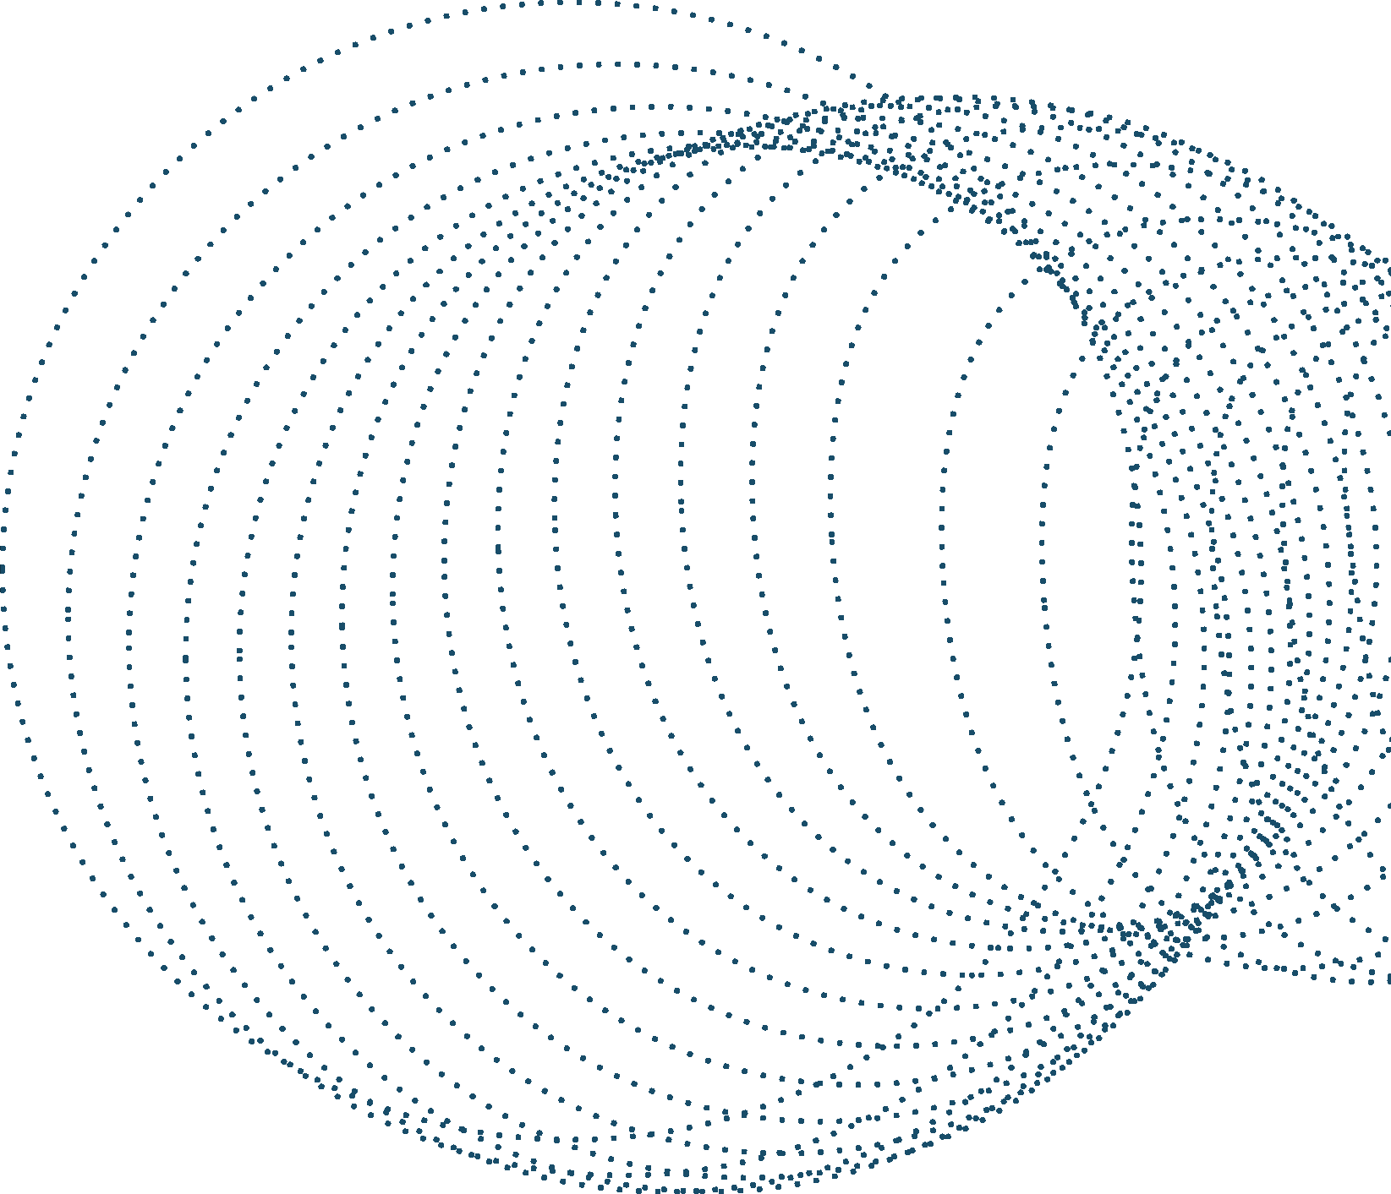
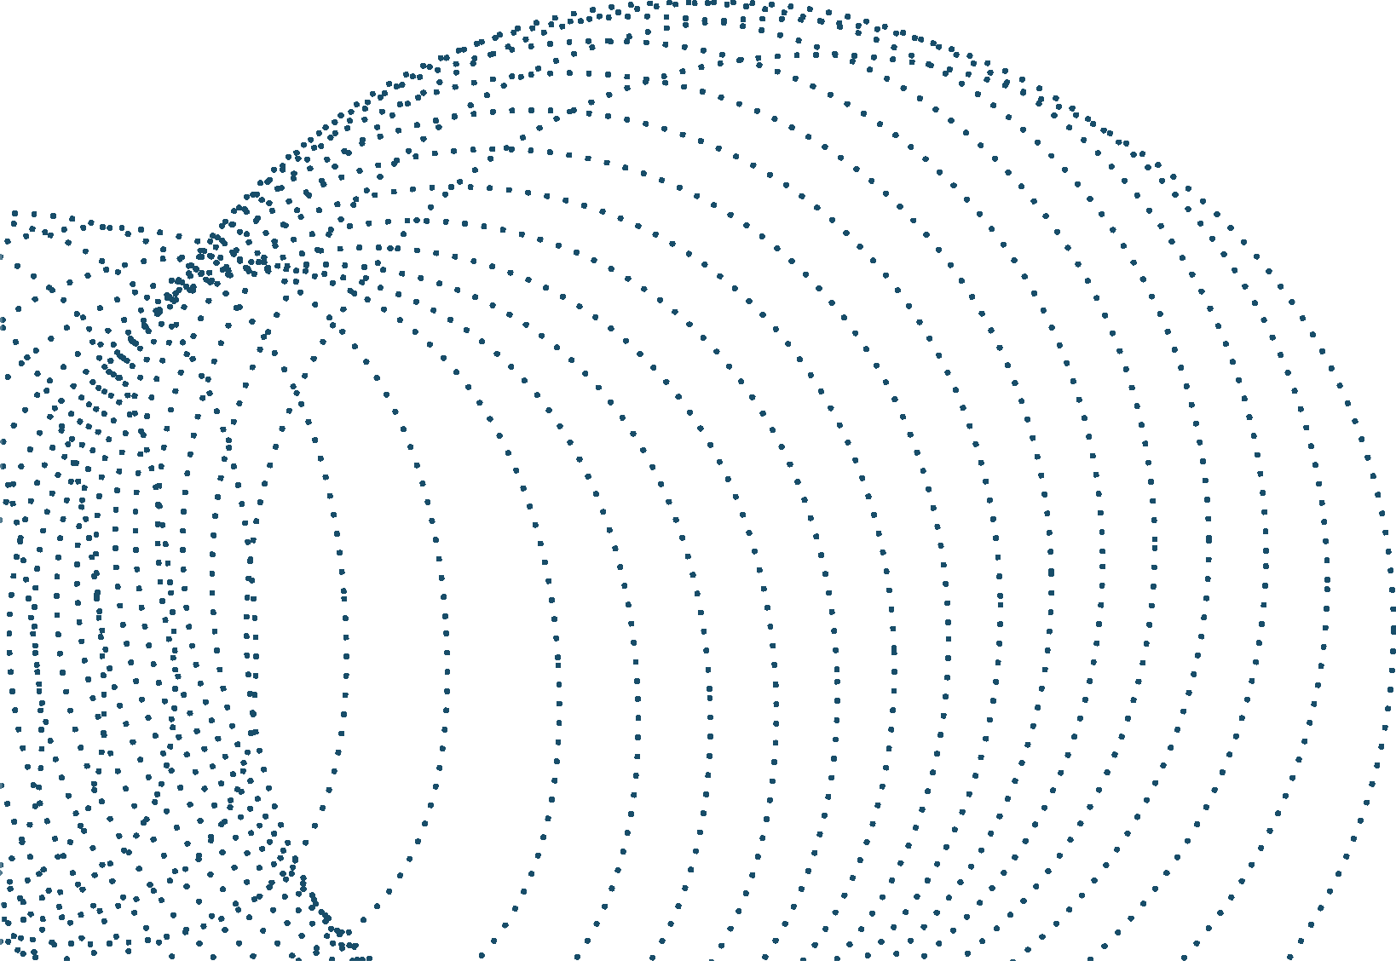
REFLECTION REMOVAL
USING GANS
Presented by QUAL-230427

Slide 2
PROBLEM STATEMENT:
Create an AI model that can automatically detect and remove reflections from photos taken through reflective surfaces (like glass windows or water). The solution should show the scene behind the reflection clearly, without adding extra blurriness or missing details.

Slide 3
INDEX
1.Introduction 2.Literature Review 3.Why GANs 4.Dataset Preparation 5.Pre-processing
6.Model Architecture 7.Workflow
8.Tools and Technology 9.Results
10.Future Prospects

Slide 4
Introduction
Reflection removal is the process of separating unwanted reflections from images, often caused by glass surfaces or other reflective mediums. Generative Adversarial Networks (GANs) have emerged as a powerful tool in addressing this problem due to their ability to generate realistic outputs and learn complex data distributions.

Slide 5

Literature
Review
Traditional Methods
Early approaches relied on optimization-based techniques, leveraging constraints like sparsity or gradient priors. However, these struggled with real-world complexity.
Deep Learning Approaches
CNNs: Zhang et al. (2018) introduced CNNs to predict layers using paired data.
GANs: Models like ERRNet use encoder-decoder structures and attention mechanisms to suppress reflections while preserving detail.
Cascaded Networks: Techniques refine results iteratively, ensuring better handling of strong
reflections.

Slide 6
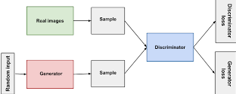
Why GANs
Generator attempts to remove reflections and reconstruct a clean image while Discriminator evaluates the realism of the generated images.
Training involves a competition between these networks, improving results iteratively.
Advantages of GANs:
Powerful Image Translation
Realistic Outputs
Feature Learning
Handles Diverse Scenarios

Slide 7
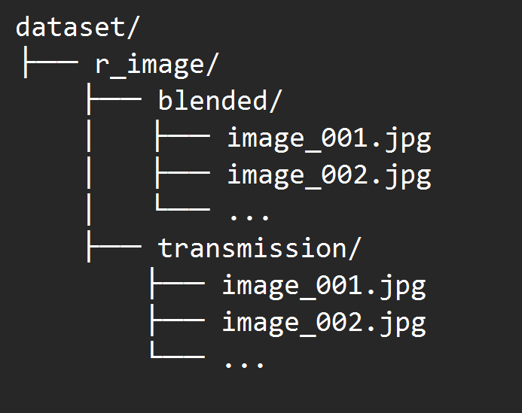

Dataset Preparation
We use PascalVOC, BerkeleyReal, SIR^2 and CEILNet images for our database. We combine all images and make r_image folder which consists of Reflective(Blended) images and Clean(Transmission) images.

Slide 8
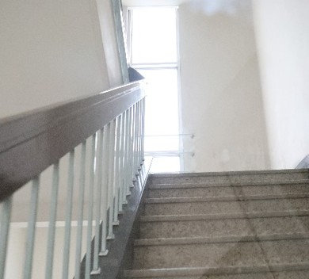
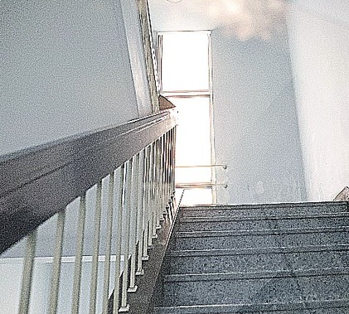

Pre-Processing
Before
After
We use following the Pre-Processing Techniques:
Resizing
Augmentation (Training Only): Image Sharpening Normalization
Tensor Conversion
Augmentations include: Random Horizontal Flip Random Vertical Flip Random Rotation
Color Jittering Brightness Contrast Saturation Hue

Slide 9
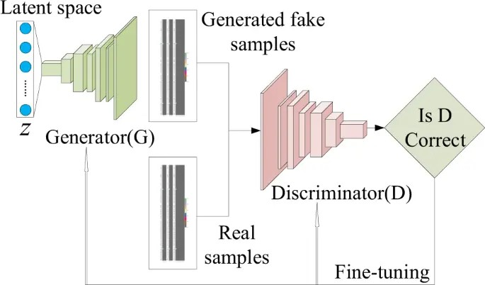
Model Architecture
Generator consists of 32 layers:
Encoder: Four convolutional blocks (Conv2d, BatchNorm2d, LeakyReLU) for feature extraction.
Bottleneck: A deeper convolutional block for advanced feature representation.
Decoder: Four deconvolutional blocks (ConvTranspose2d, BatchNorm2d, LeakyReLU) for upsampling.
Output: A final Conv2d layer followed by Sigmoid to generate the output image.
Attention: ChannelAttention and SpatialAttention modules enhance important features.
Discriminator consists of 16 layers:
Convolutional layers with LeakyReLU and BatchNorm2d, ending with a Sigmoid for real/fake classification.

Slide 10

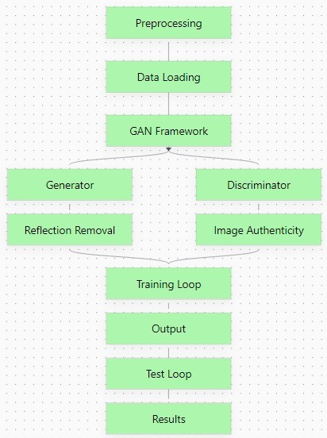
W o r k f l o w

Slide 11
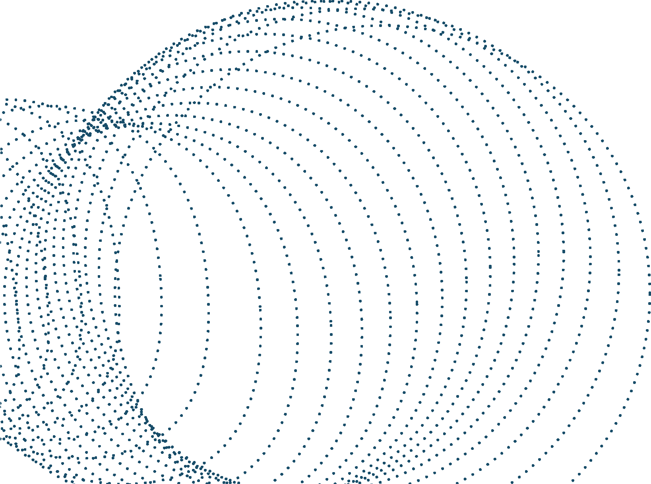

Tools & Technology
Libraries : PyTorch,
Torchvision, Pillow, NumPy, OpenCV
Programming Language: Python
IDE:
Cloud Platforms: Google cloud platform
Version Control: Git
VS Code, Google Colab, Kaggle Notebooks, Jupyter Notebooks

Slide 12
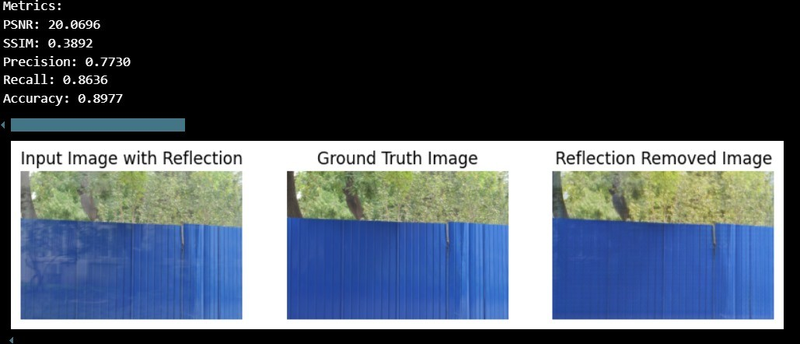
Results

Slide 13
Future Prospects
Unsupervised Learning: Develop models that work without paired training data, enabling broader applicability.
Real-Time Applications: Optimize models for real-time use in augmented reality or photography tools.
Robust Generalization: Enhance model performance across diverse reflection types, intensities, and real- world scenarios.
Cross-Domain Applications: Extend reflection removal techniques to related tasks, such as haze or shadow removal.
Efficient Architectures: Focus on lightweight models for mobile and edge devices.

Slide 14



